Slide 1

Operating Systems
Lecture 39
Syed Mansoor Sarwar

Slide 2
Agenda for Today
Review of the previous lecture
Page Replacement
Page Replacement Algorithms
  First-In-First-Out (FIFO)
  Optimal Replacement
  Least Recently Used (LRU)
Belady’s Anomaly
Stack Replacement Algorithms

Slide 3
Review of Lecture 38
Performance of Demand Paging
Process Creation
Memory Mapped Files

Slide 4
Performance of Demand Paging
Effective Access Time (EAT)
EAT = (1 – p) x memory access time
+ p (page fault service time)

Slide 5
Example
Memory access time = 100 nanosec
Page fault service time = 25 millisec
T_{effective} = (1 - p) x 100 + p (25 milli)
= (1 - p) x 100 + p (25000000)
= 100 + 24999900 x p
If one access out of 1000 causes a page fault, effective access time is 25 microseconds, a slowdown by a factor of 250.

Slide 6
Example
If we want less than 10 percentage degradation in effective memory access time then we have the following inequality
110 > 100 + 25000000 x p
10 > 25000000 x p
p < 0.0000004
This means we can allow only one page fault every 2,500,000.

Slide 7
Process Creation
“Copy-on-write”—child shares parent’s address space and is given its own copy of “copy-on-write” pages when it tries to modify them
vfork()—child shares parent’s address space; useful when child invokes exec() immediately after its creation

Slide 8
Memory-Mapped Files
Memory-mapped file I/O allows file I/O to be treated as routine memory access by mapping a disk block to a page in memory.
Automatically or by using the mmap() system call on Solaris

Slide 9
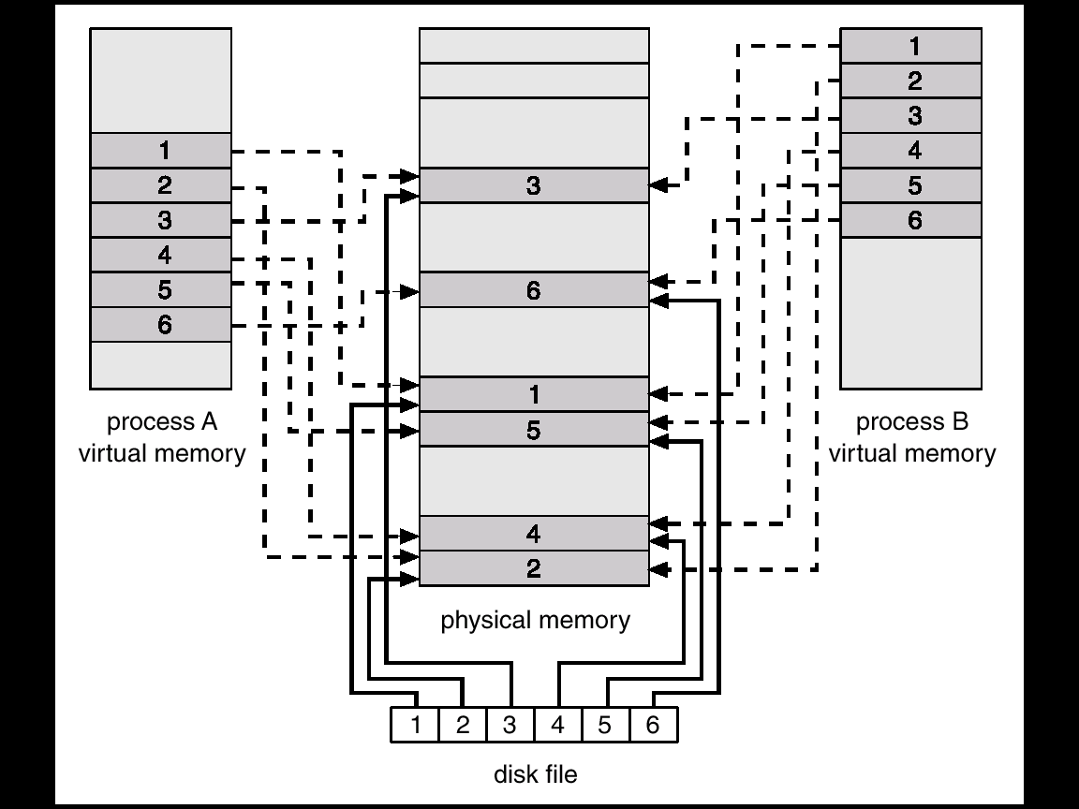
Memory-Mapped Files

Slide 10
Page Replacement
If no free frame is available on a page fault, replace a page in memory to load the desired page
Page-fault service routine is modified to include page replacement.

Slide 11
Page Replacement
Use modify (dirty) bit to reduce overhead of page transfers – only modified pages are written to disk.
  Set by hardware when data is written to a page
  Checked by OS at page replacements

Slide 12
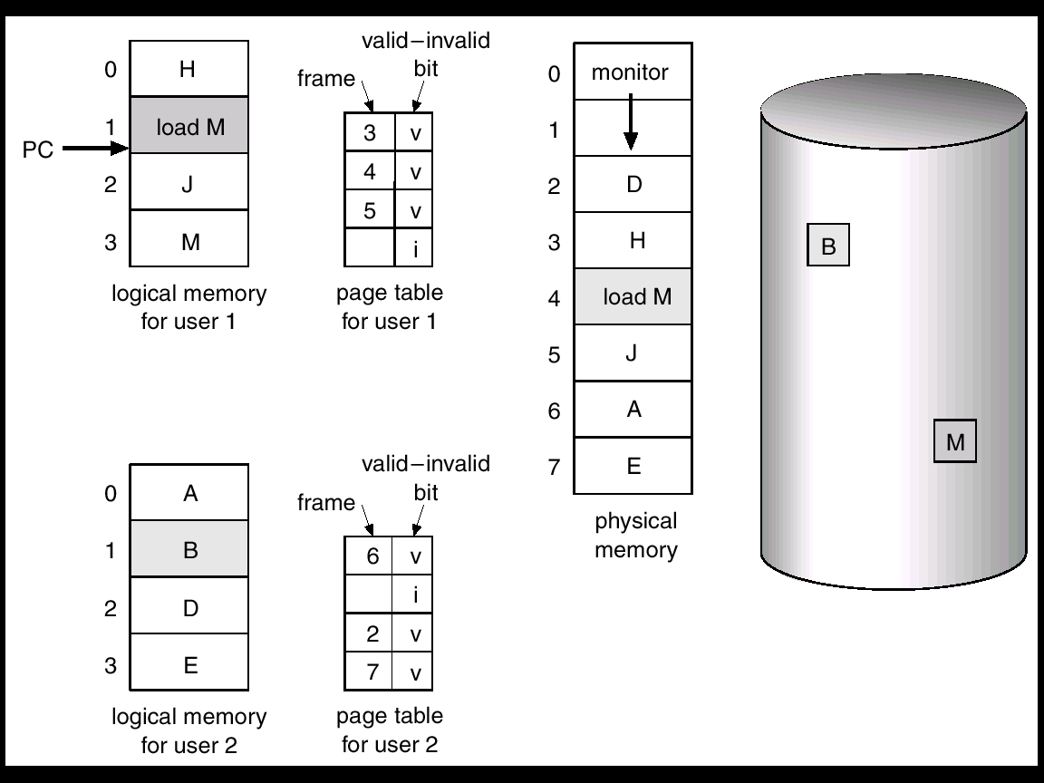
Page Replacement

Slide 13
Page Replacement
M

Slide 14

Page Replacement

Slide 15
Page Replacement Algorithms
Want lowest page-fault rate.
Evaluate algorithm by running it on a particular string of memory references (reference string) and computing the number of page faults on that string.

Slide 16

Page Faults vs. Number of Frames

Slide 17
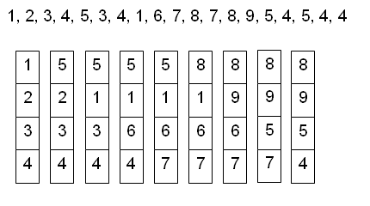
FIFO Algorithm
Number of frame allocated = 4

Slide 18
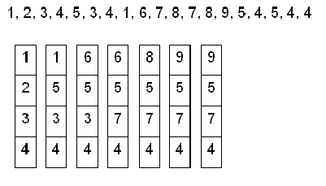
Optimal Algorithm
Replace the page that will not be used for the longest period of time.

Slide 19
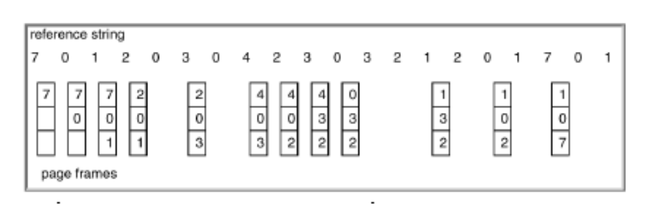
Least Recently Used (LRU) Algorithm
Replace the page that hasn’t been used for the longest period of time.

Slide 20
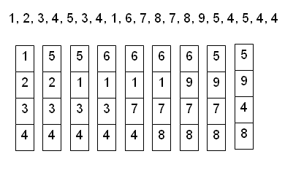
LRU Example

Slide 21
LRU Implementation
Counter-Based Implementation
  Every page entry has a counter; every time page is referenced through this entry, copy the clock into the counter.
  When a page needs to be replaced, choose the one with minimum counter value.

Slide 22
LRU Implementation
Stack-based Implementation
  Keep a stack of page numbers. Whenever a page is referenced, remove it from its current location and push it onto the stack. The LRU page is at the bottom of the stack.
  Doubly-linked list implementation of stack requires 6 pointer changes.

Slide 23
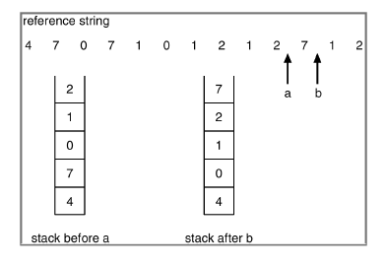
LRU Implementation

Slide 24
Recap of Lecture
Page Replacement
Page Replacement Algorithms
  First-In-First-Out (FIFO)
  Optimal Replacement
  Least Recently Used (LRU)

Slide 25
Operating Systems
Lecture 39
Syed Mansoor Sarwar

